Slide 1



Predicting Severe Asthma Exacerbations
A Genome-Wide Association Study using Random Forests Classifiers
Mousheng Xu, PhD
Dec 2025 | GTIIT’s 3rd International Symposium Presentation

Slide 2
Self Introduction
Mousheng Xu, PhD
Head of Biosciences, A Private Company In Singapore
•
20+ Years Experience: Bridging computational biology, statistical genetics, and machine learning.
•
Academic Foundation:
B.S. in Genetics (Wuhan University)
M.S. in Biochemistry & Molecular Biology, M.S. in Computer Science (University of Kansas)
PhD in Bioinformatics (Boston University; Harvard Medical School)
Postdoc in Cancer Genetic Epidemiology (Harvard T.H. Chan School of Public Health).
Key Achievements:
•
○
Led large-scale GWAS & NGS pipelines.
○
Founded Hubei Vidagen (Genetic Testing).
○
Scientific Breakthrough Award (ATS 2009).

Slide 3

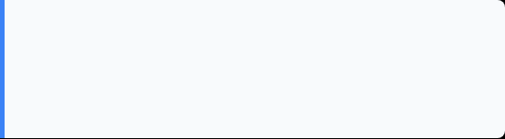

The Clinical Challenge：Severe Asthma Exacerbations
Definition
Severe Asthma Exacerbations: emergency room visit or a hospitalization for asthma symptoms.
Prognostic Significance
The ability to predict severe asthma exacerbations would therefore have direct prognostic significance and might form the basis for the development of earlier therapeutic interventions.

Slide 4






The "Small N, Large P" Problem
Sample Size (N)
Standard Method
Predictors (P)
~417
Logistic Regression
>550,000
Subjects (Trios) Childhood Asthma Management Program (CAMP)
Struggles when predictors (P) vastly outnumber samples (N). Cannot easily model complex interactions.
Single Nucleotide Polymorphisms (SNPs) + Clinical Traits

Slide 5

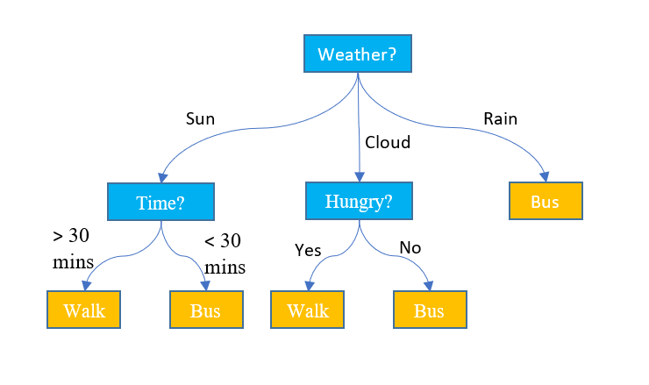

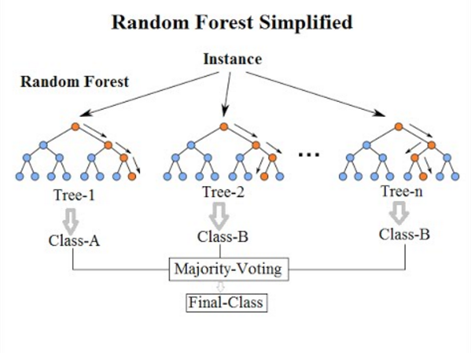
Machine Learning With Random Forests
Leveraging ensemble power for robust predictive modeling.
DECISION TREE
Key Concepts of Random Forests
A decision tree predicts outcomes by splitting data based on feature values.
An ensemble of many decision trees forms a "forest".
Each tree uses random samples of the data and considers only random features at each split, enhancing diversity.
Voting Mechanism: The model aggregates predictions by taking the votes from each decision tree to determine the final outcome.
Handles nonlinear, high-dimensional data effectively, crucial for complex datasets.
Provides valuable feature importance scores, indicating which variables are most predictive.

Slide 6





Methodology: Feature Selection
Step 1: Initial Screen
Step 2: Ranking
Step 3: Prediction
Select the top 4,000 SNPs based on initial scores. Re-run RF to refine the ranking.
Compute RF importance scores for all 550,000 SNPs in batches (chromosomal order).
Build final models using Top N SNPs (10, 40, 160, 320) + 4 Clinical Traits.
Clinical Traits Used: Age, Sex, FEV1% (Lung Function), Treatment Group

Slide 7
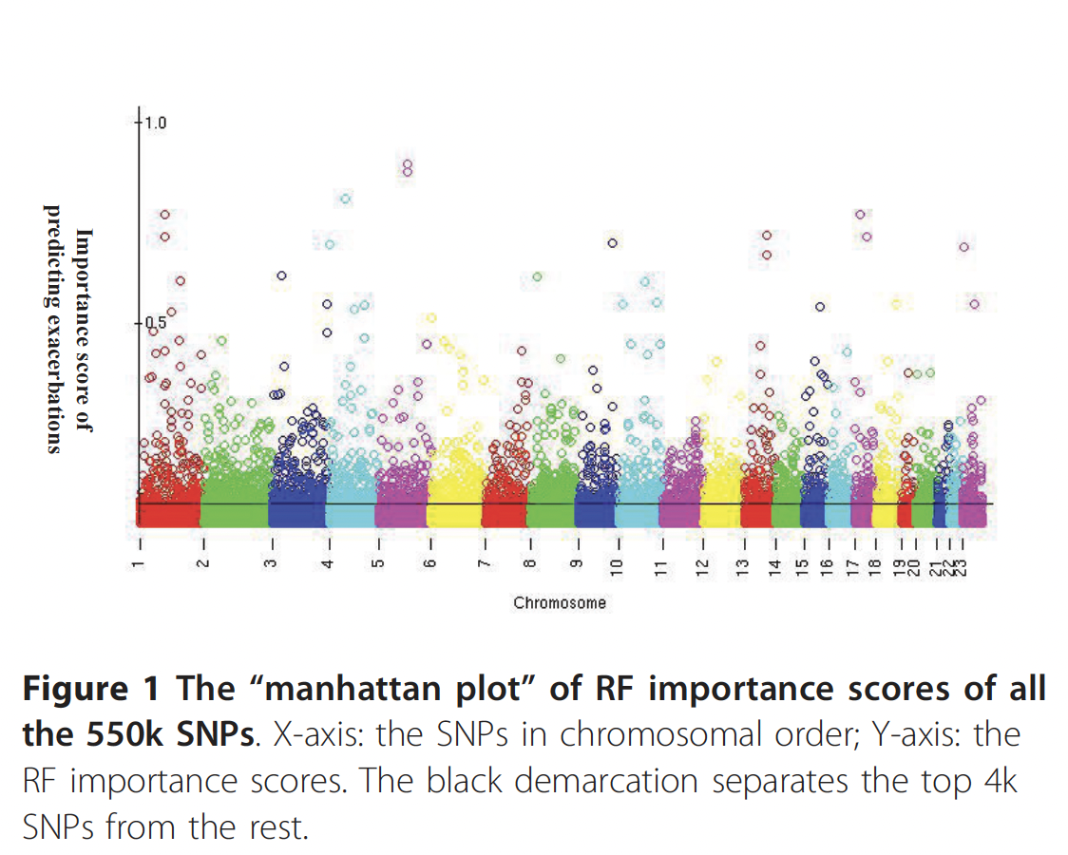
Visualizing the Signal
The RF Importance Landscape
Unlike a traditional GWAS Manhattan plot which shows -log(p-values), this plot visualizes Random Forest Importance Scores across the genome.
The "peaks" represent SNPs that contribute most significantly to classifying a patient as an "Exacerbator" vs. "Non-Exacerbator".
We identified a clear signal distinguishing the top predictive SNPs from the genomic background noise.

Slide 8
Visualizing the Signal
The RF Importance Landscape
Unlike a traditional GWAS Manhattan plot which shows -log(p-values), this plot visualizes Random Forest Importance Scores across the genome.
The "peaks" represent SNPs that contribute most significantly to classifying a patient as an "Exacerbator" vs. "Non-Exacerbator".
We identified a clear signal distinguishing the top predictive SNPs from the genomic background noise.

Slide 9
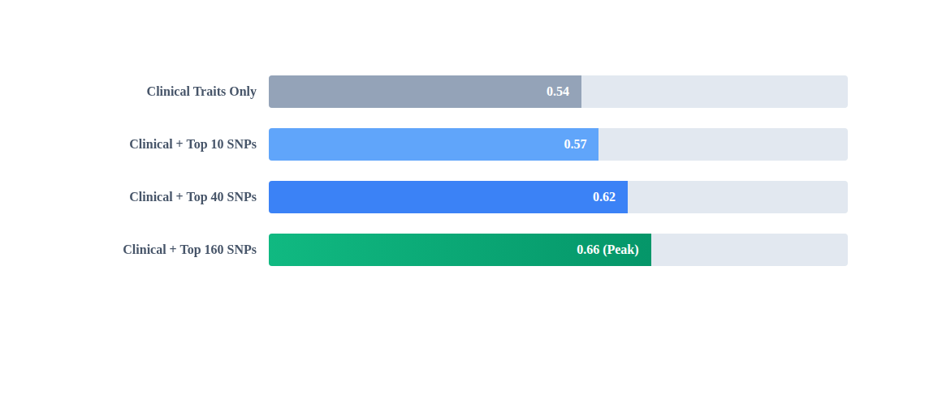
Genetics Improves Prediction
Area Under the Curve (AUC) in Independent Replication Cohort
Key Finding: Adding genetic markers significantly improved prediction over clinical history alone. The model plateaued at 160 SNPs, suggesting a robust genetic signature for exacerbation risk.

Slide 10
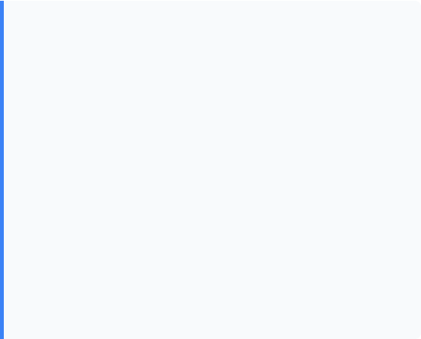
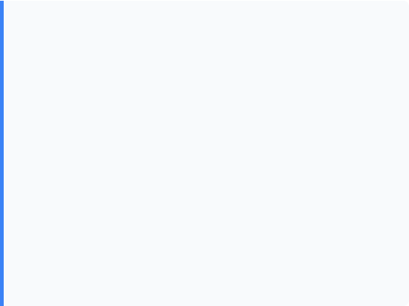


Validation & Impact
Recognition
Rigorous Validation
This work was highlighted for its innovative approach:
We did not just test on the training data.
•
Permutation Testing: Confirmed results were not due to chance.
•
ATS 2009: Featured at the "Scientific Breakthroughs of the Year" symposium.
•
Independent Replication: The model was tested on a separate cohort of 164 subjects, maintaining an AUC of 0.66.
•
Impact: Categorized as "Highly Accessed" by BMC Medical Genetics, influencing future ML-GWAS integration studies.

Slide 11

Vision: Data Science in BFE
Integrating Computation & Biology
My goal is to establish a functional lab at GTIIT that bridges the gap between biological engineering and data science.
•
Curriculum: Introducing practical ML and Bioinformatics training for students.
•
Research: Developing explainable AI pipelines for complex food and biological data.
•
Innovation: Translating large-scale "Big Data" into actionable engineering insights.

Slide 12
Thank You
Questions & Discussion
Mousheng Xu, PhD
moushengxu@gmail.com

Slide 13





Image Sources
https://media.istockphoto.com/id/1678122264/photo/doctor-helping-a-child-patient-with-an-asthma-inhaler-in-his-office-at-the-medical-clinic.jpg?s=612x612&w=0&k=20&c=UvQYXKAYKKbLMTCehwX9DoMezQmUs5JzUAbfDl5jydc=
Source: www.istockphoto.com
https://media.geeksforgeeks.org/wp-content/uploads/20250627112439534287/Random-forest-algorithm.webp
Source: www.geeksforgeeks.org
https://raw.githubusercontent.com/ngs-docs/angus/2017/files/prostate_manhattan.396.png
Source: angus.readthedocs.io
https://cdn.labmanager.com/assets/image/55331/hybrid-lab-work-s.webp
Source: www.labmanager.com

